Slide 1
PBHS 31001: Epidemiologic Methods 2024
Stata Session 6 (Logistic regression)
(Slides are adopted from previous TA’s)

Slide 2
Will Use Framingham Data for this Review Session
"U:\TA\Epi Methods W17\Homeworks\PS and Keys\frmgham2.dta“
We will be doing analysis on baseline characteristics (keep if period == 1) and prevalent or incident disease, so we can either reshape as wide or use only period 1 observations (via an “if” statement or dropping variables)

Slide 3
Review – from previous Stata Sessions
We have looked at commands to
Analyze confounding (in context of cohort study)
Poisson regression
Today:
Review binary outcomes and logistic regression
Adjusting for confounding using ‘tabodds’ & ‘mhodds’ command
Testing for trend – categorical variables

Slide 4
Logistic regression in Stata
Main command:
Logit – report results as coefficients; can add the or option to get odds ratios
Logistic- report results as odds ratio
Let’s look at the stata notes adopted from previous year

Slide 5
Some other syntax we will learn today:
tabodds [outcomeIndicator] [exposureVar], or
tabodds [outcomeIndicator] [exposureVar], or base([n])
tabodds [outcomeIndicator] [exposureVar], ciplot
tabodds [outcomeIndicator] [exposureVar], graph
tabodds [outcomeIndicator] [exposureVar], graph yscale(log)
mhodds [outcomeInd] [exposureCat], by [confoundInd]

Slide 6
Testing for trend – categorical variables
“Is increasing exposure associated with increasing probability of the outcome?”
Versus “Is exposure associated with outcome?”
This is called “testing for trend”
For use with ordered categorical variables (e.g. BMI is ordered. Race is not)
tabodds [outcomeIndicator] [exposureVar]

Slide 7
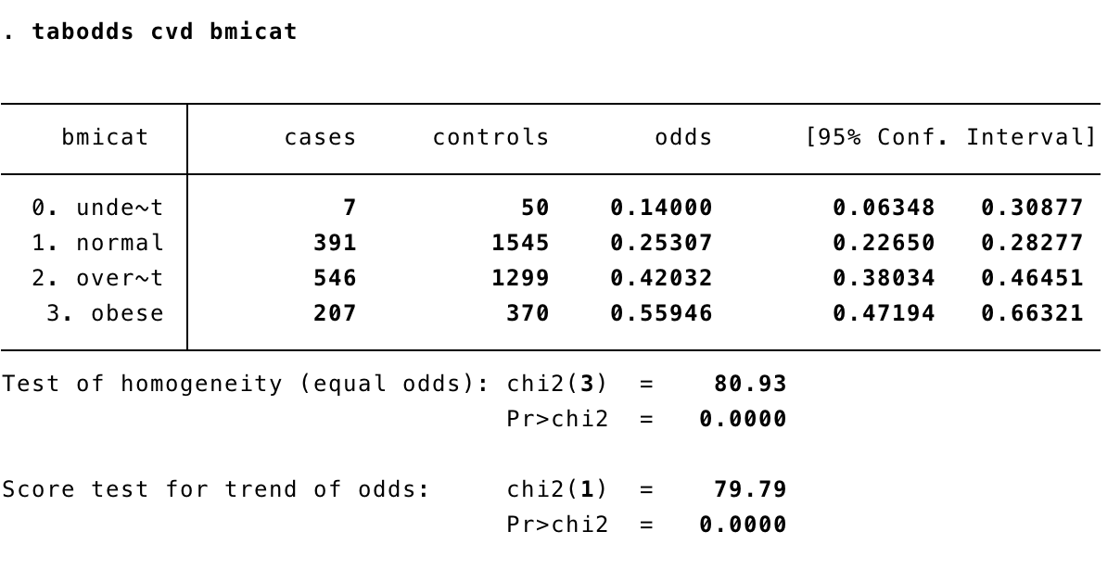
Testing for trend – categorical variables
Stata
Score test for trend of odds
If p is less than 0.05, then you reject the hypothesis that there is no linear trend relationship
Interpretation: if p < 0.05, you think that as your categories increase, the probability of your outcome also increases

Slide 8
Testing for trend – categorical variables
Stata
tabodds [outcomeIndicator] [exposureVar], or
Gives odds ratios, using the first category as a reference
tabodds [outcomeIndicator] [exposureVar], or base([n])
Gives odds ratios, using the nth category as a reference
tabodds [outcomeIndicator] [exposureVar], ciplot
Gives visualization of the trend
tabodds [outcomeIndicator] [exposureVar], graph
tabodds [outcomeIndicator] [exposureVar], graph yscale(log)

Slide 9
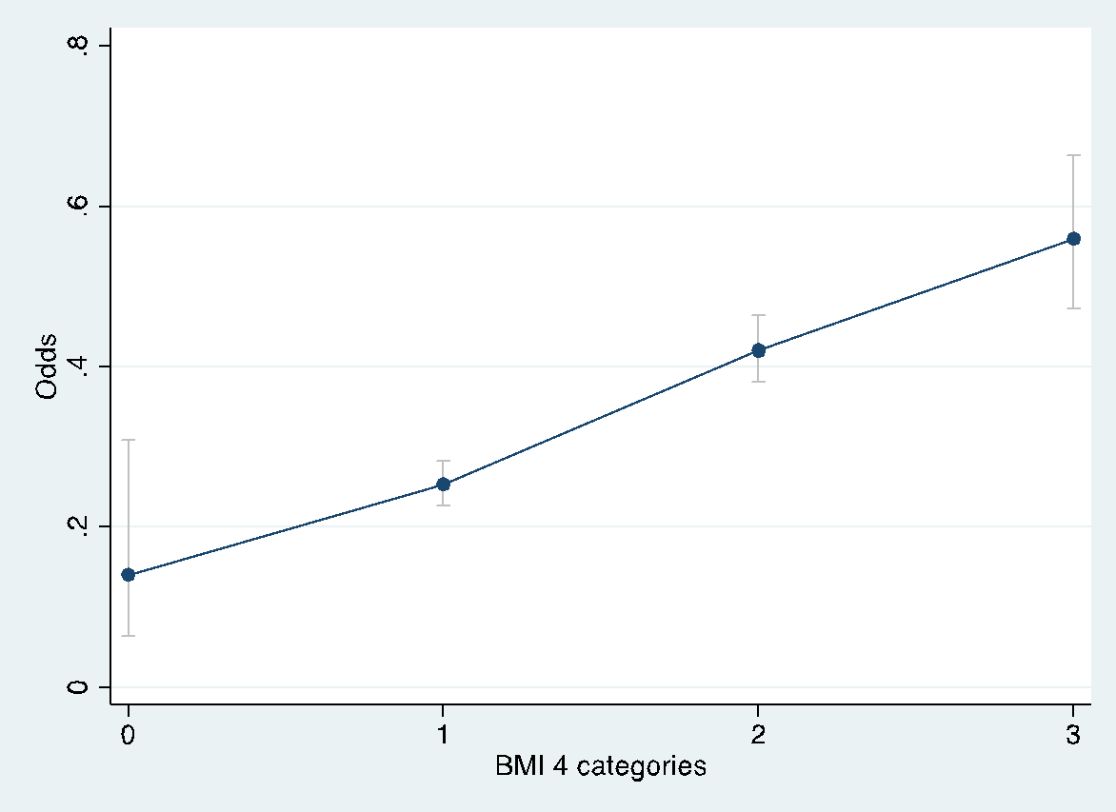
Trend test is important for our decisions about how to treat variables

Slide 10
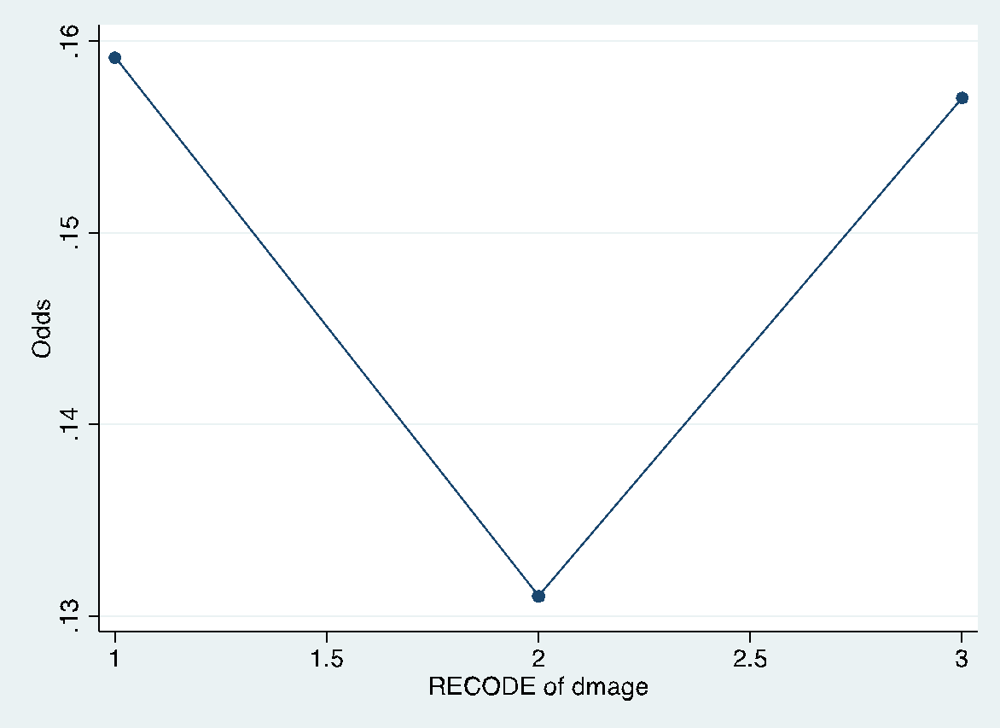
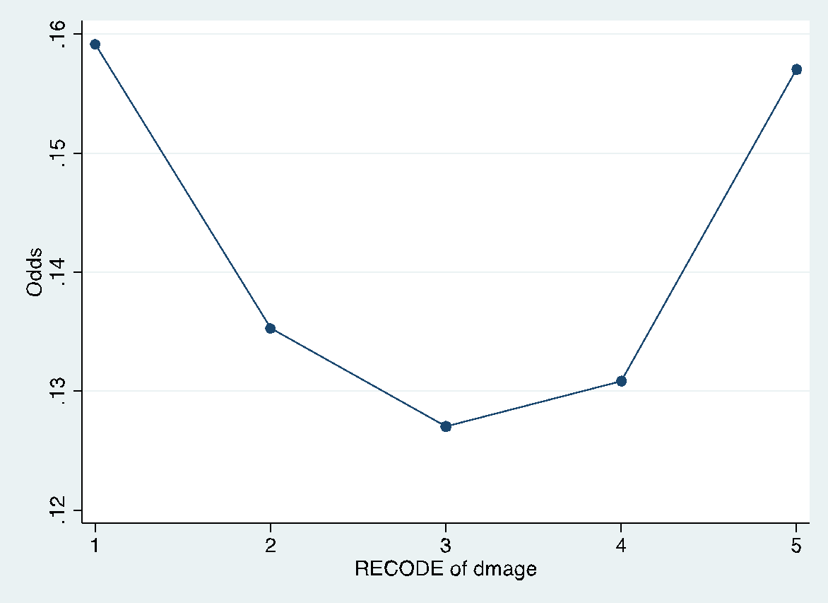
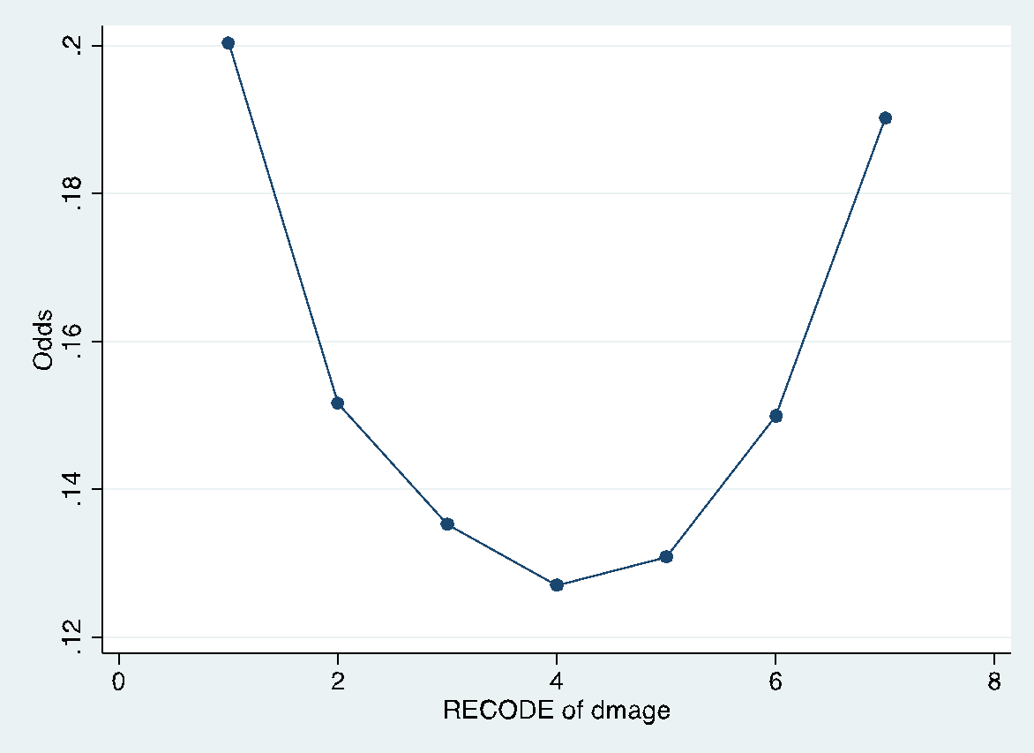
How you categorize your variable matters
Notes:
Note: when see curve like this, test if quadratic term makes it better

Slide 11
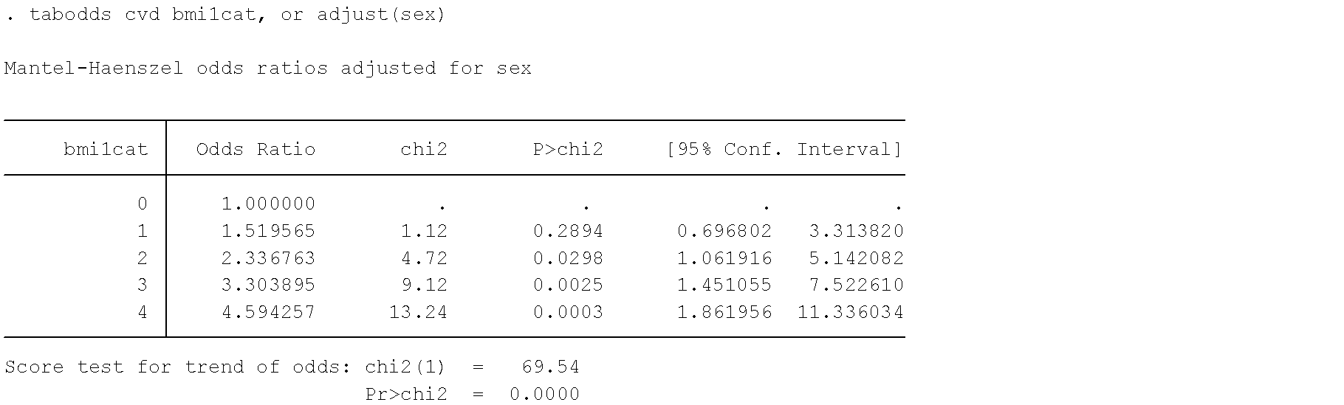
Review: Testing for trend – with adjustment
Stata
tabodds [outcomeIndicator] [exposureVar], or adj [confVar]
Gives odds ratios, adjusts for potential confounding variable

Slide 12
mhodds Command
Similar to tabodds, but
Will calculate test for trend based on one-unit increase in your exposure
ie: both magnitude AND order matter
Allows you to stratify based on possible confounders
tabodds answers two questions:
Are the odds same for all exposure levels?
If they are not the same, do they follow a linear trend?
mhodds answers two questions
Is there a linear trend?
What is the OR comparing exposures that have a 1-unit difference between them

Slide 13
From Stata manual: tabodds vs. mhodds
https://www.stata.com/manuals13/stepitab.pdf
tabodds is used with case –control and cross-sectional data. It tabulates the odds of failure against a categorical explanatory variable expvar. If expvar is specified, tabodds performs an approximate χ 2 test of homogeneity of odds and a test for linear trend of the log odds against the numerical code used for the categories of expvar. Both tests are based on the score statistic and its variance; see Methods and formulas. When expvar is absent, the overall odds are reported. The variable varcase is coded 0/1 for individual and simple frequency records and equals the number of cases for binomial frequency records.
mhodds is used with case –control and cross-sectional data. It estimates the ratio of the odds of failure for two categories of expvar, controlled for specified confounding variables, varsadjust, and tests whether this odds ratio is equal to one. When expvar has more than two categories but none are specified with the compare() option, mhodds assumes that expvar is a quantitative variable and calculates a 1-degree-of-freedom test for trend. It also calculates an approximate estimate of the log odds-ratio for a one-unit increase in expvar. This is a one-step Newton–Raphson approximation to the maximum likelihood estimate calculated as the ratio of the score statistic, U, to its variance, V (Clayton and Hills 1993, 103).
Notes:
Mhodds assumes monotone increasing

Slide 14
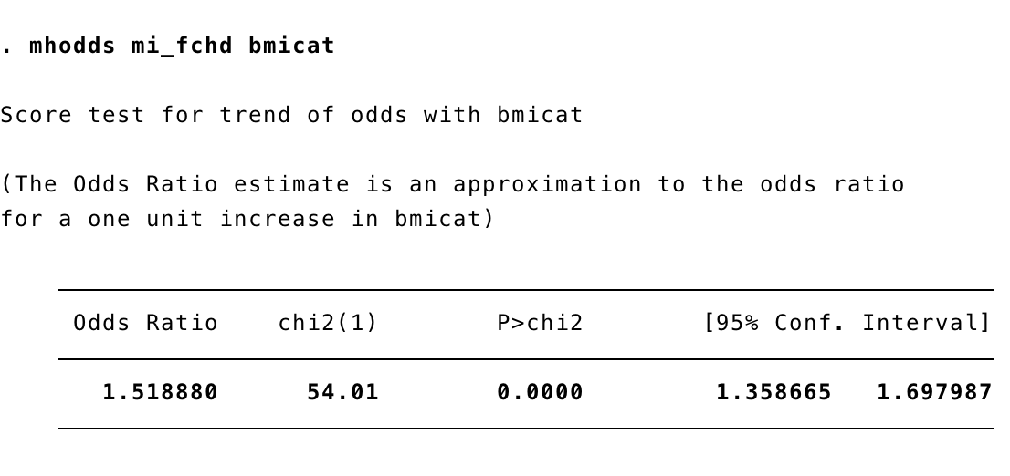
mhodds Command
Stata
mhodds [outcomeInd] [exposureCat]

Slide 15
Effect Modification - Review
Confounding:
When a third variable is associated with both the outcome and exposure of interest.
a nuisance effect, obscuring a true relationship; it may be contextual
threat to causal inference
Interaction/Effect Modification:
When the relationship between the outcome and exposure of interest is different for different values of a third variable
a characteristic that exists independently of study design or sample; it is a real effect of interest
not a threat to causal inference
The purpose of data analysis is to remove confounding and detect interaction.

